Slide 1
Urgent Care or Emergency Room
Know Before You Go

Slide 2

Topics
Knowing what your choices are
How to make the best decision for you and your family
How that decision effects your pockets
Notes:
Topics that will be covered during this module are.
Knowing what your choices are
How to make the best decisions for you and your family
How your decisions effect your pocket

Slide 3
Your Options for Immediate Healthcare Needs
Call or see my doctor
Go to urgent care
Go to ER or call 911
$
Medical copayment or coinsurance
Access to medical files
$$
20 – 30% coinsurance after the deductible
Go to convenience care clinic
Open Access and CDHP only
$$$
$400 copayment or
20-30% coinsurance
After the deductible
$
65 copayment or
Notes:
Knowing your choices can save you and your family a lot of money.
Your Primary Care provider visit is the easiest on your pocket and they actually know more about you since they have your medical files.
Add information on Convenience Care Facility
Urgent care is the next one
Leaving the emergency room option the most costly, even more reason you should only use for true emergencies.

Slide 4
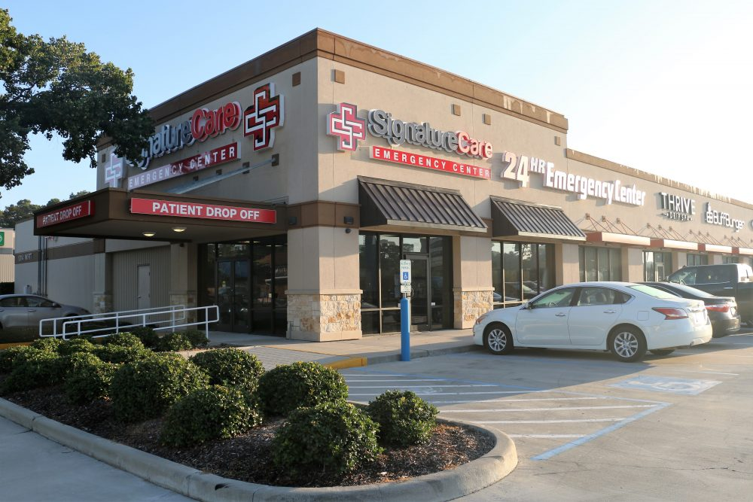
Is this an Urgent Care Facility?
Notes:
I would like to share with you a scenario: It is Thursday at 7pm and you slipped and cut your hand. You got the bleeding under control, but you think you may need stitches, so you head out to find na Urgent care facility. You are driving and you spot this location. Would pull in to be seen here?
In this case this location is both a Freestanding Emergency Room 24/7 and Urgent Care only during Urgent Care hours.
This is why it is important to know where to go.
You will have to be very responsible and ask the right question up front:
“Is this an Urgent Care facility?” is not the right question to ask.
The correct question to ask is “will this visit be billed as an Urgent Care visit?”

Slide 5
Do You Know the Difference?
Urgent Care
Freestanding ER
Emergency Room
Notes:
Do you know the difference between these?
Let’s take a closer look at each one.

Slide 6
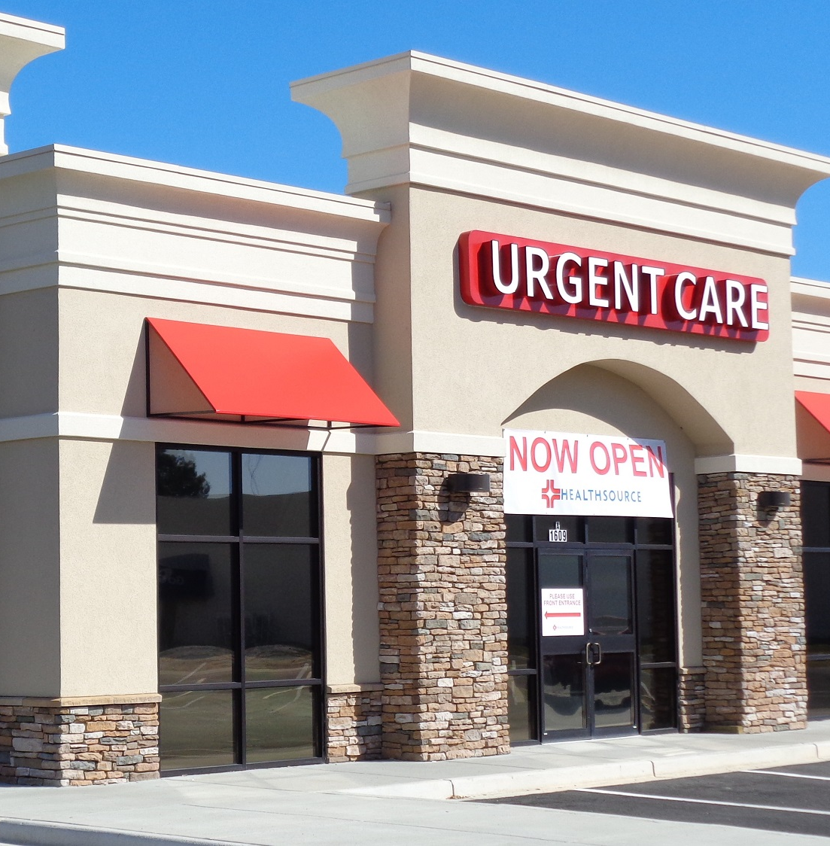
Urgent Care
Similar to a walk-in clinic
Delivers ambulatory care in a dedicated medical facility
Outside of a traditional emergency room
Primarily treat injuries or illnesses requiring immediate care
Notes:
Urgent Care facilities are great to go to for non life threating conditions, when you can not get into see your Primary Care provider.

Slide 7
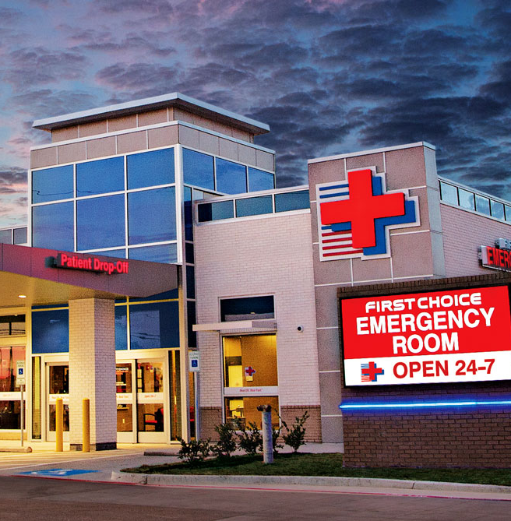
Freestanding Emergency Room
Must be staffed with experienced emergency medicine physicians
24 hours a day
Has the same diagnostic equipment as a hospital-based ER
Notes:
Remember this important tip. If the sign reads Emergency Room, the fees are the same as going to a Hospital Emergency Room.

Slide 8
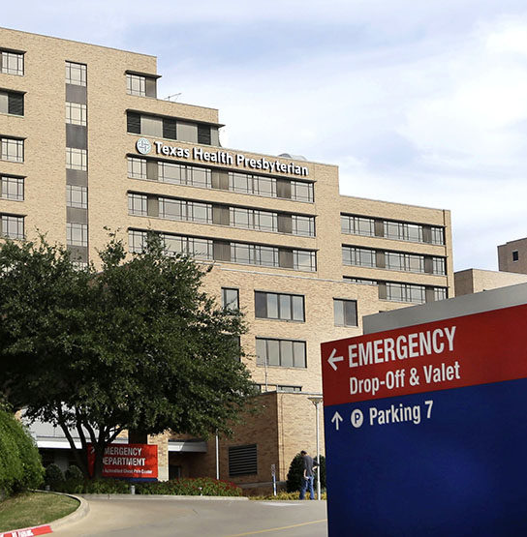
Hospital Emergency Room
Medical treatment facility staffed with experienced emergency medicine physicians
Available 24 hours a day
  Usually found in a hospital or other primary care center
Specializing in:
  Emergency medicine
  Acute care without prior appointment
Notes:
Emergency departments of most hospitals operate 24 hours a day,
Treating a spectrum of illnesses and injuries, some of which may be life-threatening and require immediate attention.
Only true emergencies are covered out of network.

Slide 9
Conditions Comparison
Urgent Care
Emergency Room
Minor cuts, sprains, burns,
Uncontrolled bleeding
Seizure or loss of consciousness
Shortness of breath
Chest pain
Head injury/major trauma
Rashes, fever and flu symptoms
Headaches
Chronic low back pain
Notes:
Here is a side by side comparison of the conditions treated at an Urgent Care facility vs the Emergency Room

Slide 10

Urgent Care and Children
Not all Urgent Care facilities treat children
Ask if the location services children and what ages before you go
Notes:
Not all Urgent Care facilities treat children
Ask if the location services children and what ages before you go

Slide 11

Need Help Assessing Where to Go?
A team of registered nurses are available 24/7/365 to help determine if you:
  Should call 911 now and seek care now
  Can be treated at an urgent care clinic
  Need to make an appointment with your Primary Care Provider
  Could try home treatment
Call Cigna’s 24 Health Information Line at 800-997-1406, option 5
Cigna’s 24 Health
Information Line
800-997-1406
Notes:
To help you assess where to go for call the the Cigna 24 Health Information line, 1-800-997-1406, option 5, to speak to a nurse.

Slide 12
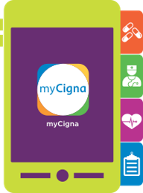
Know Who to Call
Dial the toll-free number on the back of your Cigna ID card 1.800.997.1406.
Use the mycigna.com mobile app & follow the directions below to locate an urgent care near you.
Cigna mobile app instructions:
  On the Dashboard click on the 3 lines in the top left hand corner
  Select Find Care & Costs
  Select See All next to Nearest Urgent Care
  A list of Urgent Care facilities should populate.
Notes:
Call 1-800-997-1406 or download the MyCigna App on your phone for quick access to many resources and answers to many of your questions.

Slide 13
Review: What are your choices?
Primary Care Physician
Urgent Care
Emergency Room
Medical copay or coinsurance
Lowest cost
$65 copayment
or 20-30% coinsurance after deductible
$400 copayment or 20-30% coinsurance after deductible
Notes:
Do you know the difference between these?
Let’s take a closer look at each one.

Slide 14
Questions?
All Cigna products and services are provided exclusively by or through operating subsidiaries of Cigna Corporation, including Cigna Health and Life Insurance Company, Connecticut General Life Insurance Company, Cigna Behavioral Health, Inc., and HMO or service company subsidiaries of Cigna Health Corporation. The Cigna name, logo, and other Cigna marks are owned by Cigna Intellectual Property, Inc.
000000 00/15 © 2015 Cigna. Some content provided under license.
Notes:
Now I would like to open the floor to your questions that were not covered in the FAQ’s

